Slide 1
k-Means

Slide 2
What is k-Means?
AKA Cluster Analysis
Unsupervised learning
No true x and y variables
Find the center points of different data groups

Slide 3
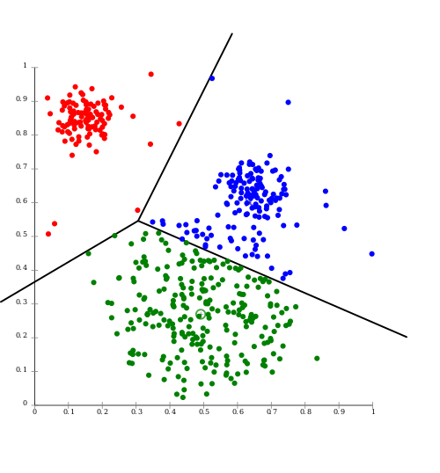
Each of the color sets is a “cluster”

Slide 4
General Steps in k-means
Data Wrangling
Fit the data
Interpret the clusters by looking at:
Labels
Plots
Aggregation

Slide 5
Data Wrangling Requirements
Convert strings to numeric with recoding

Slide 6
Performing the Analysis
Specify the number of clusters
Fit the data
Plot the data
Label the data
Interpret the data

